Slide 1
1
CHAPTER 3: TRANSISTOR MOSFET
Trang Ho
VKU, Jan-2024

Slide 2
Chapter 3: MOSFET
Introduction
Classifications
  JFET
  D-FET (Depletion MOS)
  MOSFET (Enhancement E-FET)
DC biasing
Small signal analysis
Equivalent small signal circuit

Slide 3
FET Introduction
High input impedance, nMΩ-n100MΩ
Controlled by voltage (≠ BJT)
Low power consumption
Low noise, suitable for small signal
Low impact of temperature
Using as switch for low power application
Small size and adapt for integrated circuit

Slide 4
Classification
JFET-Junction Field Effect Transistor
🞑 N and P channels
MOSFET-Metal Oxide Semiconductor FET
🞑 Depletion MOS
  N and P channels
🞑 Enhancement MOS
  N and P channels

Slide 5
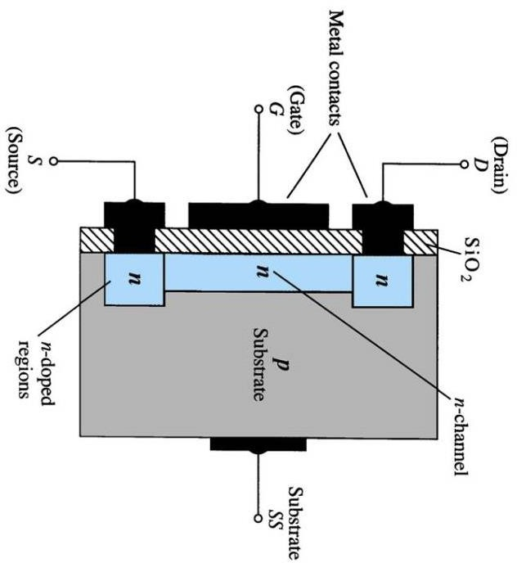
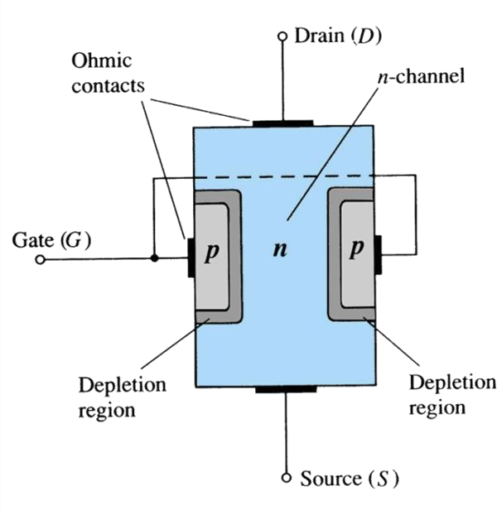
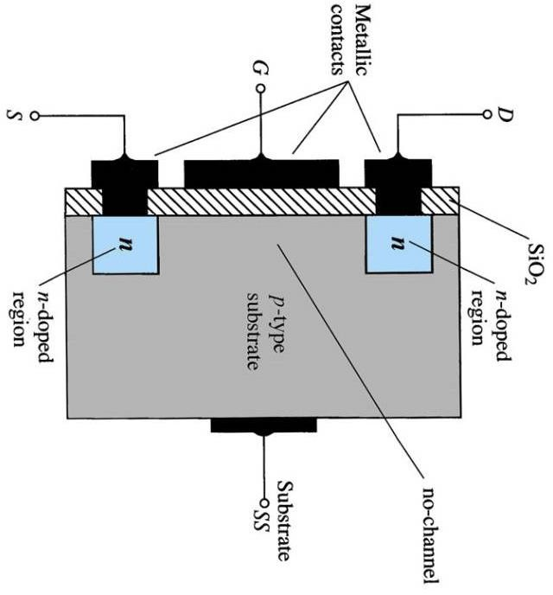
Classification (cont’d)
◻ JFET ◻ D-FET
E-FET (MOSFET)

Slide 6
JFET
Structure and Operation
Characteristic Curve
Compare with BJT
Examples, datasheets

Slide 7
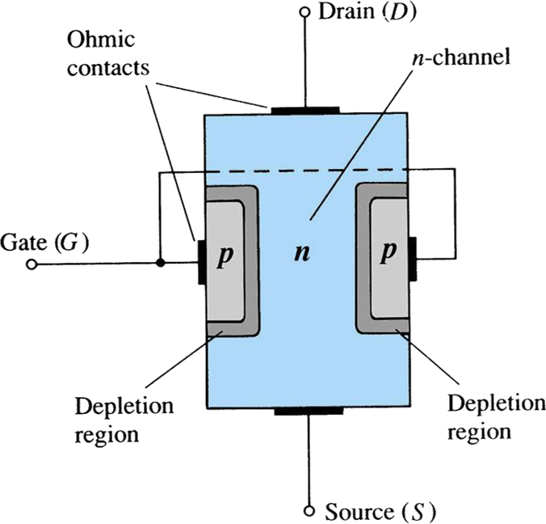
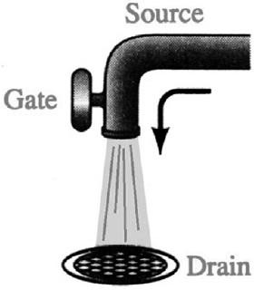
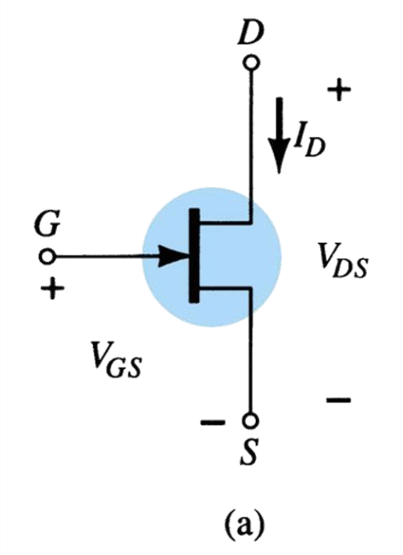
JFET – Structure
7

Slide 8
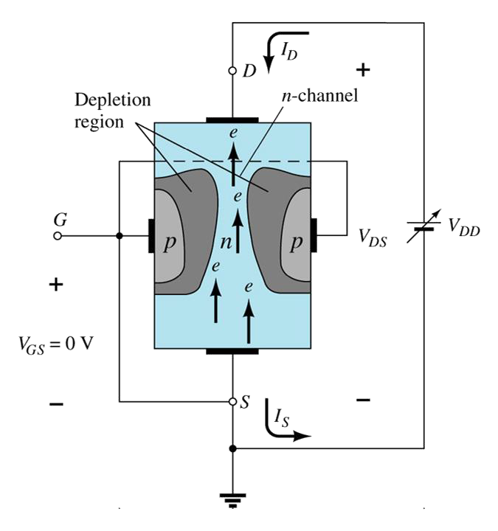
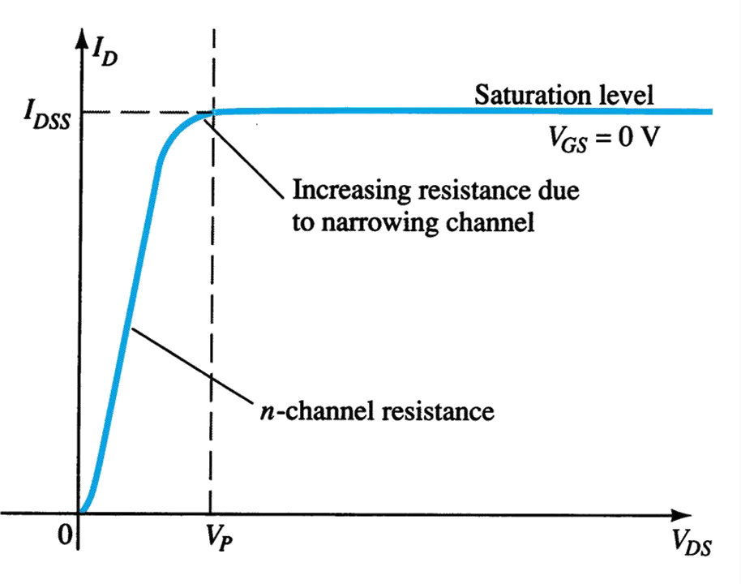
JFET – Operation
V_{GS} = 0, V_{DS}>0 increase gradually, I_{D} increases and then saturates

Slide 9
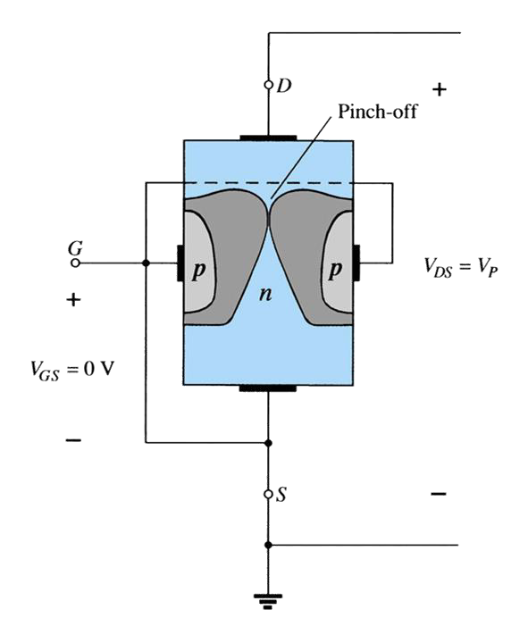
JFET – Operation
V_{GS} = 0, V_{DS} = V_{P}, I_{D} = I_{DSS}
V_{P} : pinch off voltage (pinch-off)
I_{D} = I_{DSS}(1 - V_{GS}/V_{P})²

Slide 10
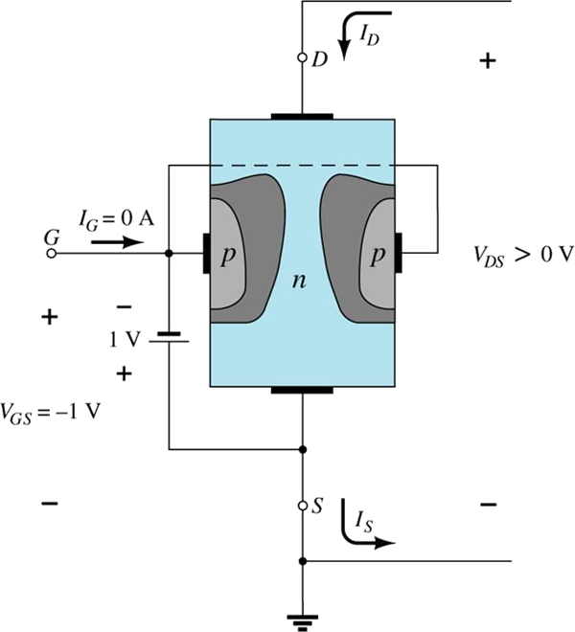
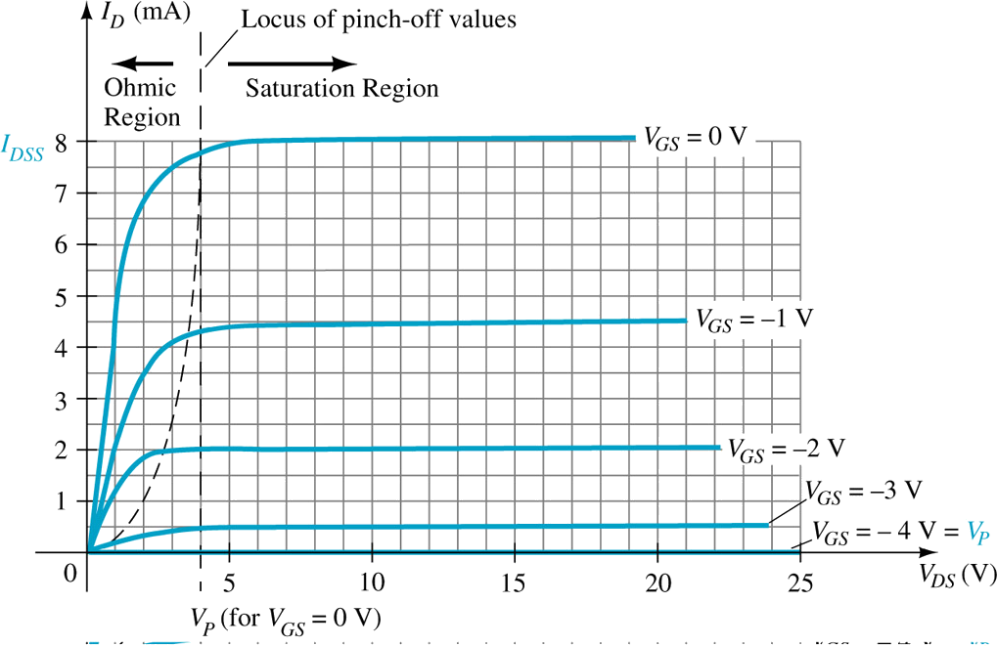
JFET – Operation
V_{GS} < 0, V_{DS} > 0, Saturation current reduces when V_{GS} → V_{pinch-off}
V_{GS} = V_{P}, I_{D} = 0

Slide 11
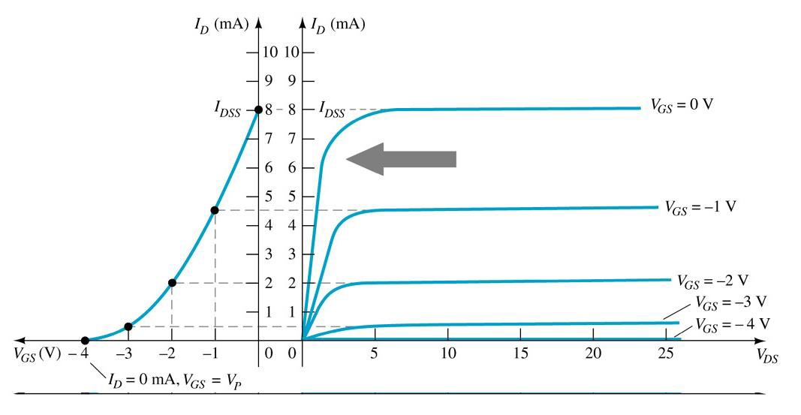
JFET – Characteristic Curves
I_{D} = f(V_{GS}) Shockley equation:
I_{D} = I_{DSS}(1 - V_{GS}/V_{P})²
I_{G} ≈ 0A
I_{D} = I_{S}
(gate current)
(I_{D} drain current, I_{S} source current)

Slide 12
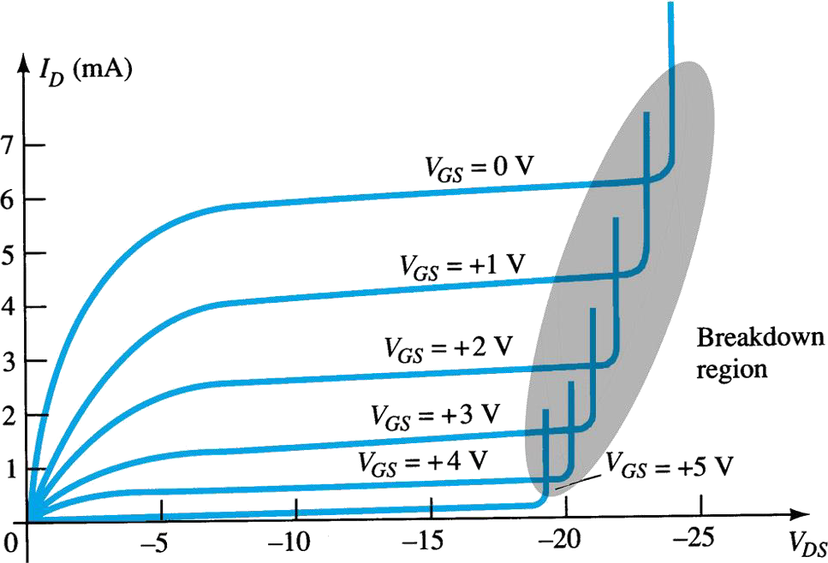
JFET – Characteristic Curves
N-channel, I_{DSS} = 8mA, V_{P} = - 4V
P-channel, I_{DSS} = 6mA, V_{P} = 6V

Slide 13
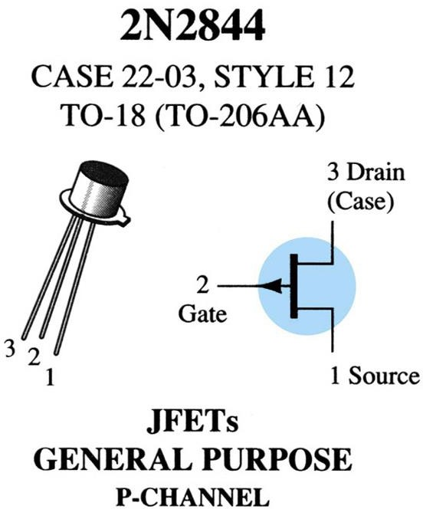
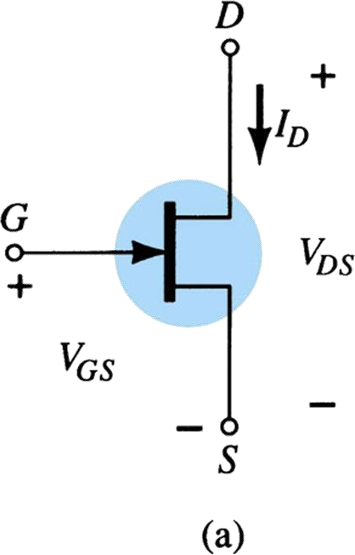
JFET – Symbol
13

Slide 14
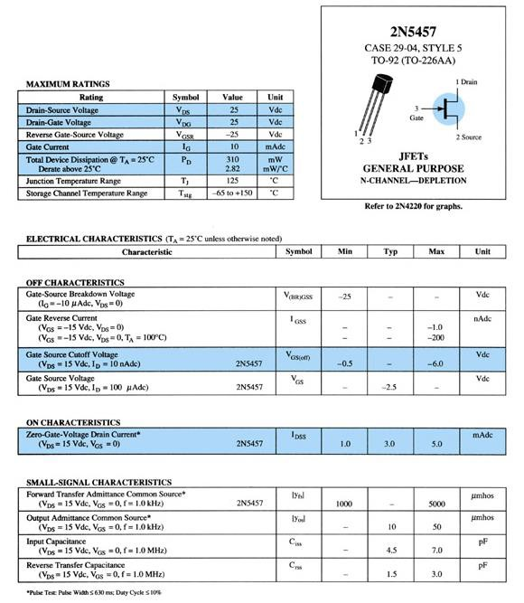
JFET
2N5457
14

Slide 15
Datasheet-2N5457
Rating | Symbol | Value | Unit
Drain-Source voltage | ^{V}DS | 25 | Vdc
Drain-Gate voltage | ^{V}DG | 25 | Vdc
Reverse G-S voltage | ^{V}GSR | -25 | Vdc
Gate current | I_{G} | 10 | nAdc
Device dissipation 25⁰C Derate above 25⁰C | P_{D} | 310 2.82 | mW mW/⁰C
Junction temp range | T_{J} | 125 | 0_{C}
Storage channel temp range | ^{T}stg | -60 to +150 | 0_{C}

Slide 16
Datasheet-2N5457-characteristics
Characteristic | Symbol | Min | Typ | Max | Unit
^{V}G-S breakdown | ^{V}(BR)GSS | -25 |  |  | Vdc
^{I}gate reverse(Vgs=-15, Vds=0) | ^{I}GSS |  |  | -1.0 | nAdc
^{V}G-S cutoff | ^{V}GS(off) | -0.5 |  | -1.0 | Vdc
^{V}G-S | ^{V}GS |  | -2.5 | -6.0 | Vdc
^{I}D-zero gate volage | ^{I}DSS | 1.0 | 3.0 | 5.0 | mAdc
^{C}in | ^{C}iss |  | 4.5 | 7.0 | pF
^{C}reverse transfer | ^{C}rss |  | 1.5 | 3.0 | pF

Slide 17
MOSFET
Structures
Operation
Characteristic Curves

Slide 18
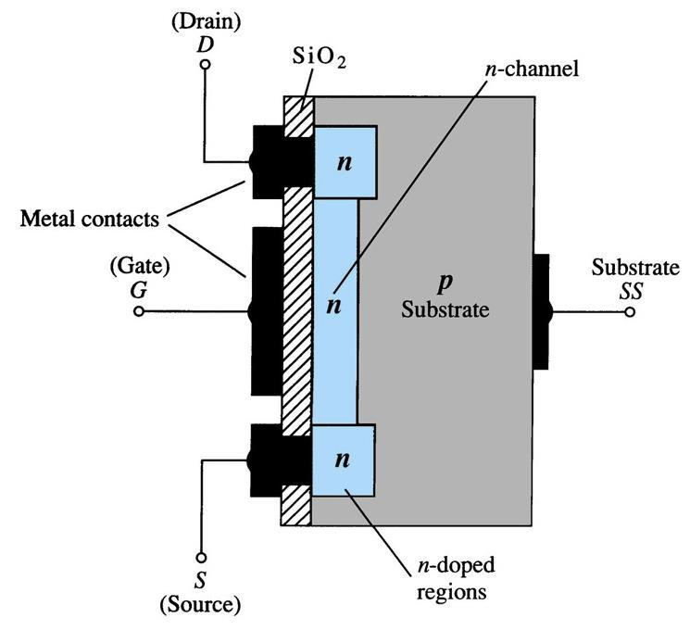
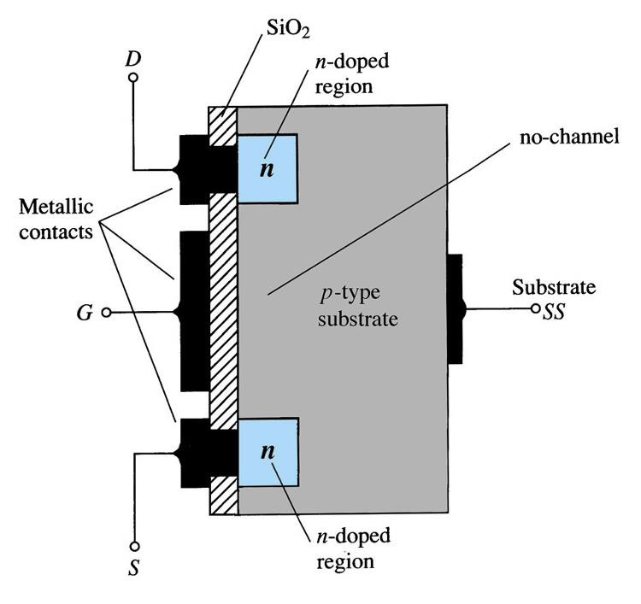
MOSFET – Structure
N-channel Depletion DMOS
N-channel Enhancement EMOS

Slide 19
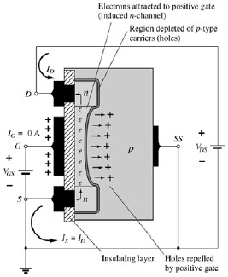
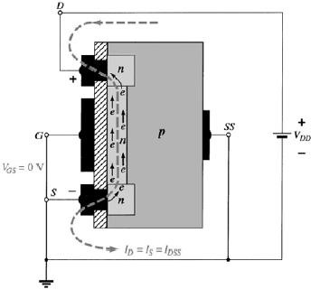
MOSFET – Operation
N-channel DMOS
V_{GS} = 0, V_{DS} > 0
N-channel EMOS
V_{GS} > V_{TH}, V_{DS} > 0

Slide 20
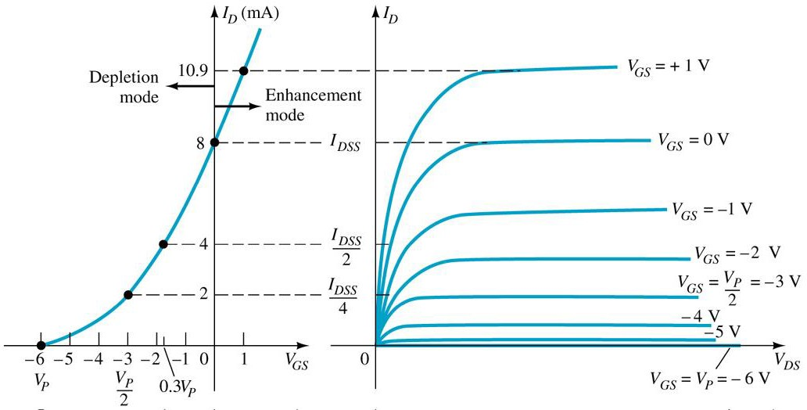
DMOS – Transfer characteristic curves
Similar to JFET, transfer characteristic curve I_{D} = f(V_{GS})
follows Shockley equation: I_{D} = I_{DSS}(1 - V_{GS}/V_{P})²
Can work at: V_{GS} > 0, I_{D} > 0

Slide 21
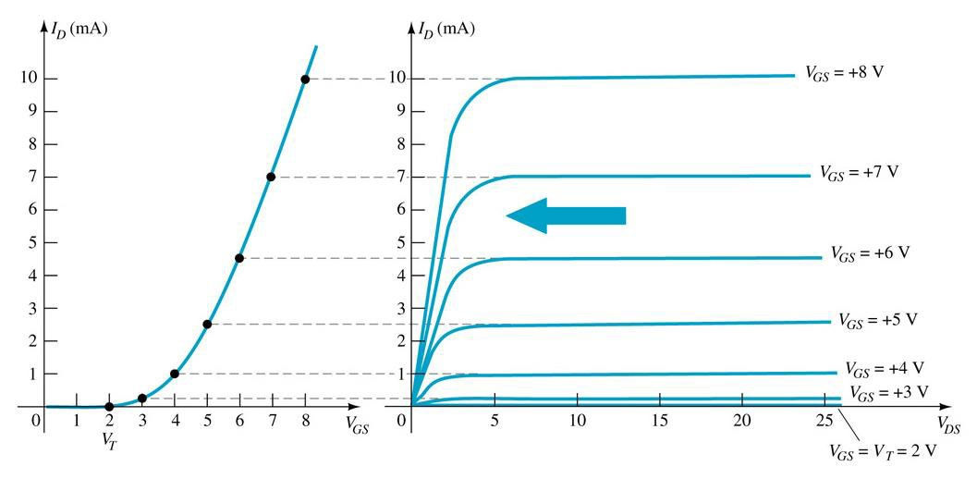
EMOS – Transfer characteristic curve
Transfer characteristic curve:
I_{D} = k(V_{GS} – V_{T})² with V_{T} > 0 (for NMOS) and Vt< 0 for PMOS)
When V_{GS} < V_{T}, I_{D} = 0

Slide 22
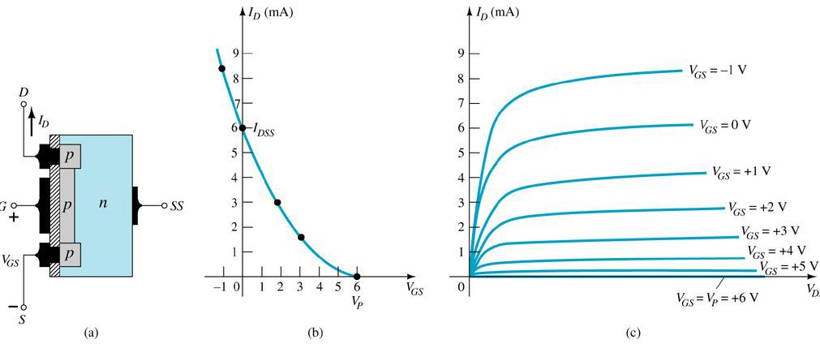
MOSFET – Transfer characteristic curve
P-channel depletion

Slide 23
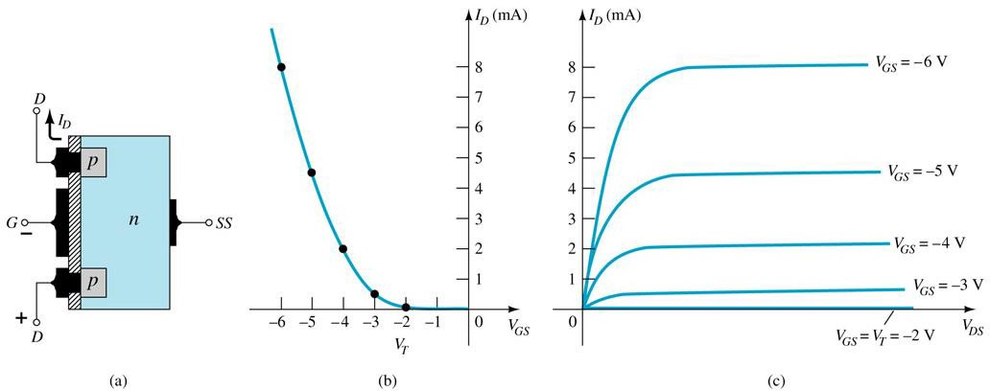
MOSFET – Transfer characteristic curve
P-channel enhancement

Slide 24
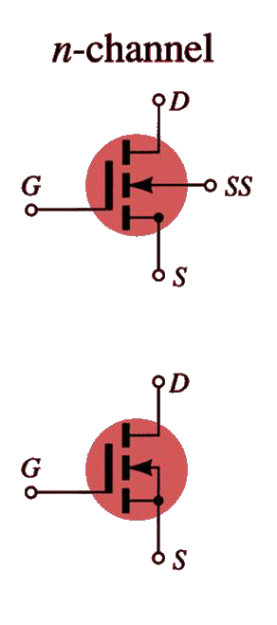
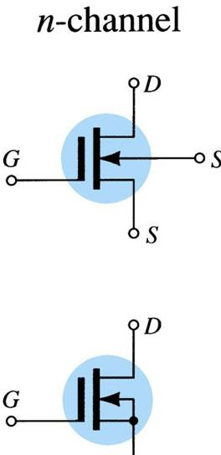
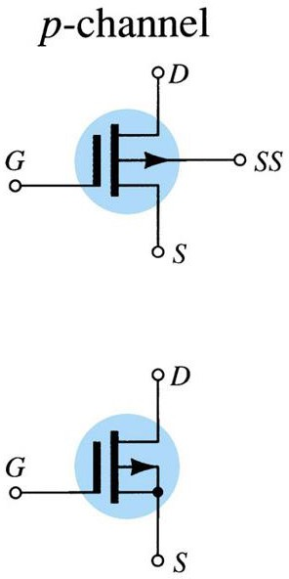
MOSFET – Symbol
DMOS
EMOS

Slide 25
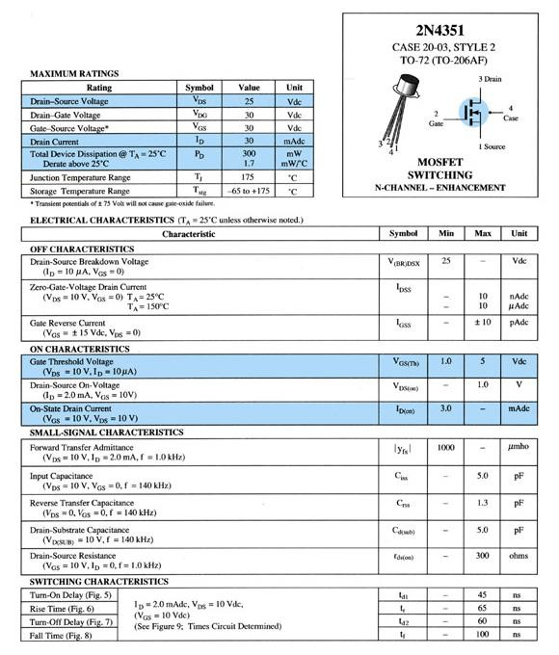
EMOS
²⁵ 2N4351

Slide 26
Datasheet-2N4351-EMOS
Characteristic | Symbol | Min | Max | Unit
^{V}DS breakdown | ^{V}(BR)DSX | 25 |  | Vdc
^{I}D-zero gate volage, Vds=10V,Vgs=0, 25C – 150C | ^{I}DSS |  | 10 10 | nAdc µAdc
^{I}gate reverse(Vgs=+-15, Vds=0) | ^{I}GSS |  | +-10 | nAdc
^{V}DS on Voltage | ^{V}DS(on) |  | 1.0 | V
^{C}in(Vds=10V,Id=2mA,f=140kHz) | ^{C}iss |  | 5.0 | pF
^{C}DS(Vdsub=10V,f=140KHz) | ^{C}rss |  | 5.0 | pF
^{R}DS(Vgs=10V,Id=0,f=1KHz) | ^{R}ds(on) |  | 300 | ohms

Slide 27
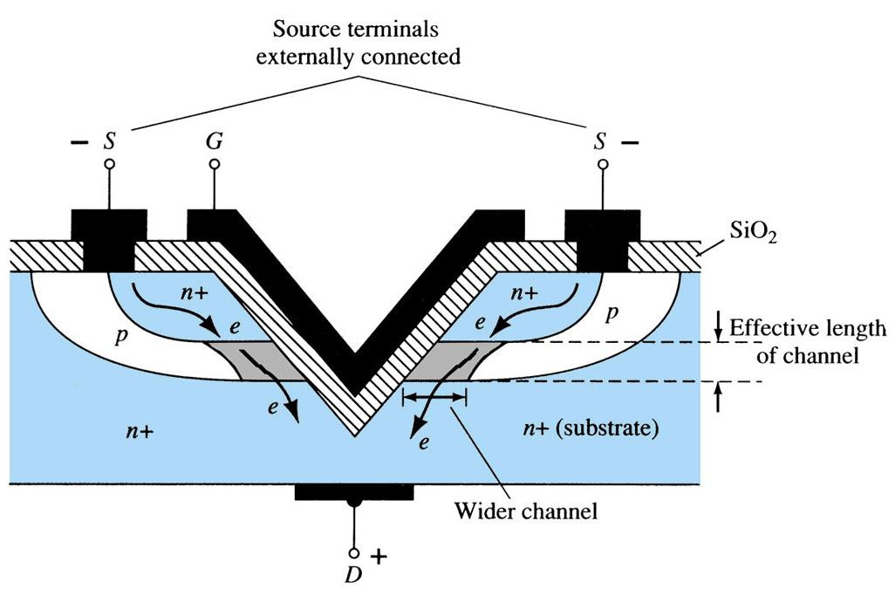
VMOS
VMOS – Vertical MOSFET, increase channel length
Increase drain current thanks to large space of heat release
High switching speed

Slide 28
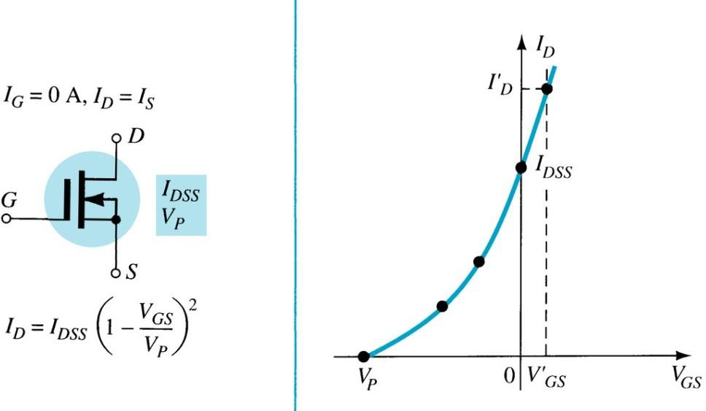
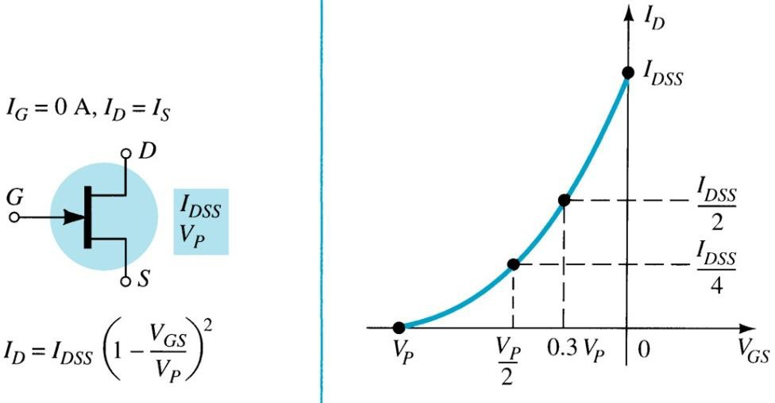
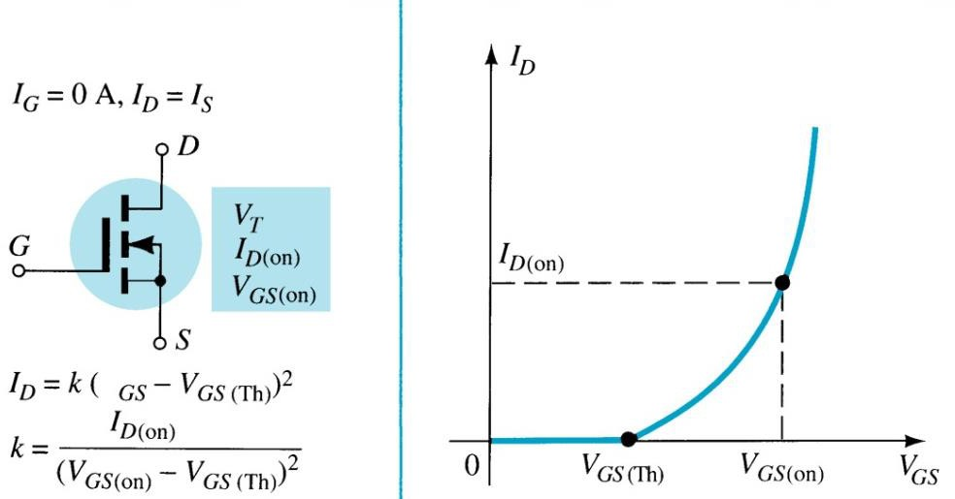
Resume
JFET
DFET
MOSFET

Slide 29
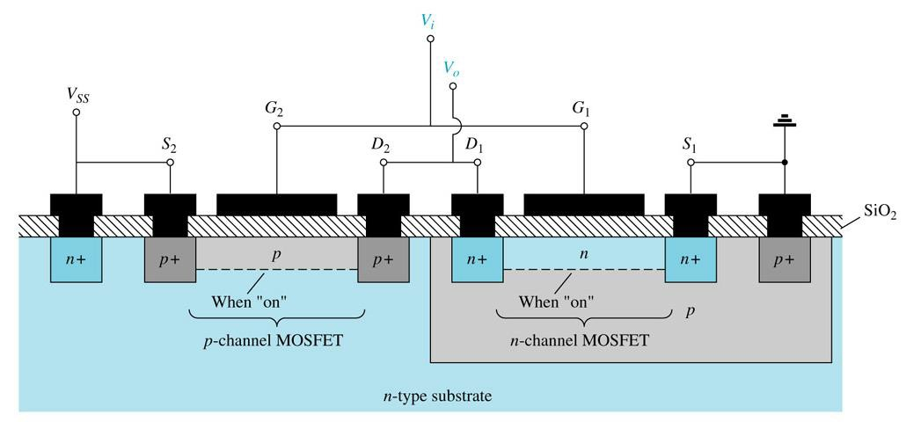
CMOS
CMOS=Complementary MOSFET
pMOS và nMOS: fabricated on same wafer
Reduce size and power consumption, increase switching speed
Analog/Digital IC design

Slide 30
Biasing types
Fixed bias
  Self-biasing
Voltage divider biasing
Feedback biasing

Slide 31
Some noted
With all kinds of FET:
I_{G} = 0A I_{D} = I_{S}
For JFET & D-MOSFET:
I_{D} = I_{DSS}(1 – V_{GS}/V_{P})²
For E-MOSFET (MOSFET):
I_{D} = k(V_{GS} – V_{T})² (saturation mode)
Determine Q-point (DC operating point) and DC load line

Slide 32
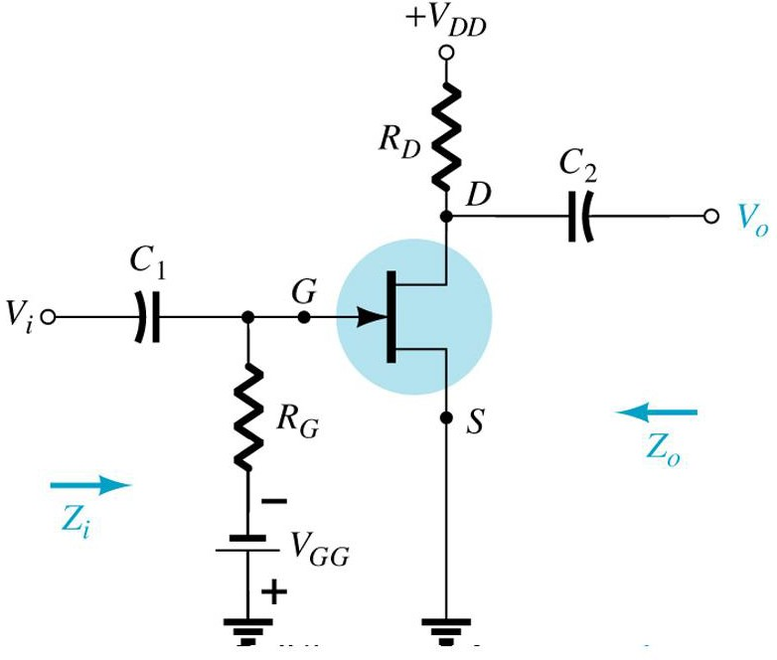
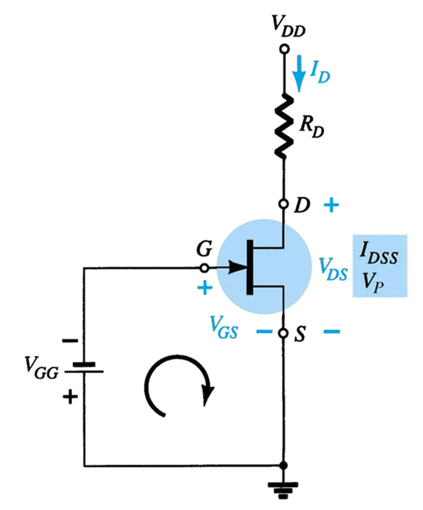
Fix biasing (ex: JFET)
I_{G} = 0A
V_{S} = 0
V_{GS} = V_{G} = - V_{GG} I_{D} = I_{DSS}(1-V_{GS}/V_{p})²
V_{G} is fixed at V_{GG}

Slide 33
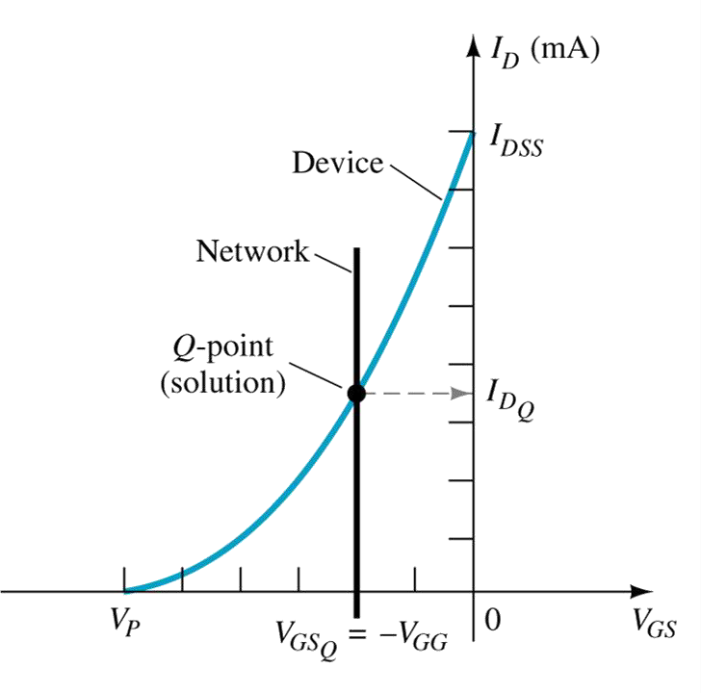
Fix biasing
I_{D} = I_{DSS}(1-V_{GS}/V_{P})²
Build transfer characteristic curve from this table:
^{V}GS | I_{D}
0 | ^{I}DSS
0.3V_{P} | I_{DSS}/2
0.5Vp | I_{DSS}/4
V_{P} | 0mA
DC load line:
V_{GS} = - V_{GG}
Intersection between DC load
line and trans. Charact. Curve
➔ Q point

Slide 34
Temperature effect
Leakage current I_{GSS} increases when t0 increases ➔ cannot neglect RG at mentioned previously so:
Q will move from :
^{V}GS ^{= V}GG ^{+ I}GSS^{*R}G
new Q-point

Slide 35
Impact of temperature
Question: If V_{GG}=-1V& R_{G}=1 MΩ. I_{GSS}=1nA at 25°C and increase
double when temperature increases 10ºC. Determine V_{GS} at 125ºC ?

Slide 36
Impact of temperature
Question: If V_{GG}=-1V& R_{G}=1 MΩ. I_{GSS}=1nA at 25°C and increase double when temperature increases 10ºC. Determine V_{GS} at 125ºC ?
Answer:
At 25ºC, I_{GSS}×R_{G}=10⁻⁹×10⁶ = 1mV, can
be neglected when compare with V_{GG}= -
1V (or new V_{GS}= -999mV).
new Q-point
When Temp. increases to 125ºC, current I_{GSS} increases to 2¹⁰ times ( ≈10³)
I_{GSS} = 10³ ×1nA =1µA
I_{GSS}× R_{G}=1µA* 1MOhm = 1V
New Q point: V_{GS} = 0V & I_{D} = I_{DSS}
Q point at 125⁰C is shifted to a new point and it is far from the initial Q point at room temperature

Slide 37
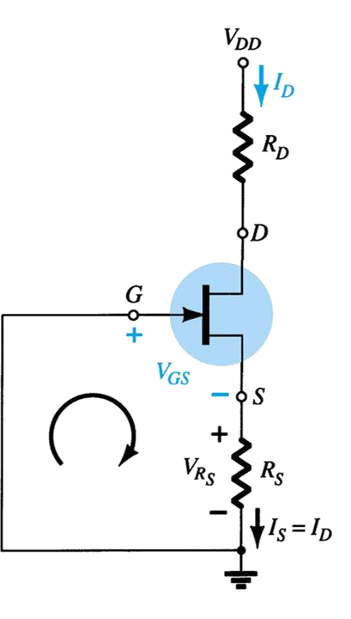
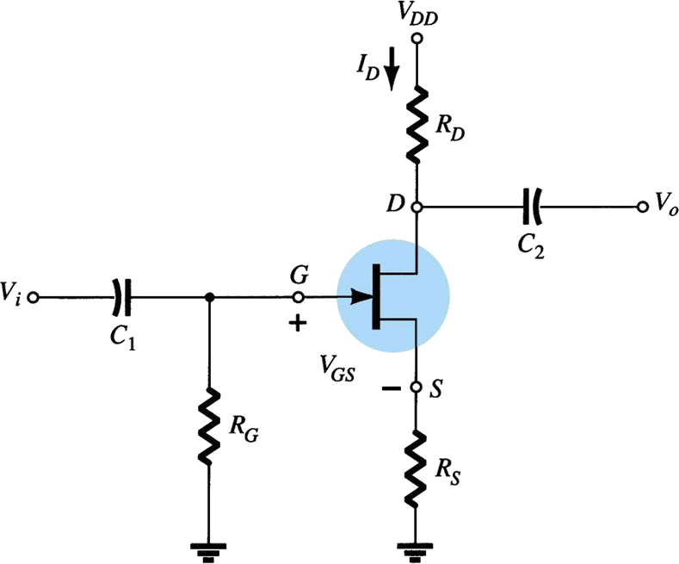
Self biasing
What is the main difference compared to fixed biasing?
Role of R_{S}?
Remove R_{G} to reduce impact of temperature?

Slide 38
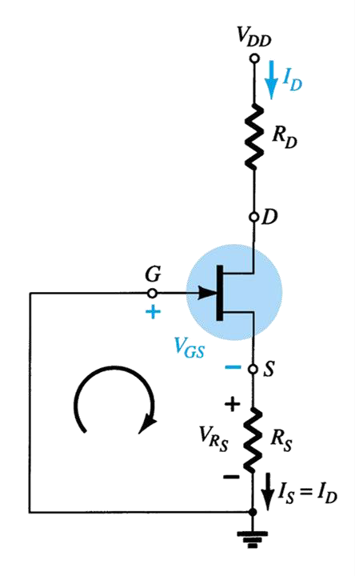
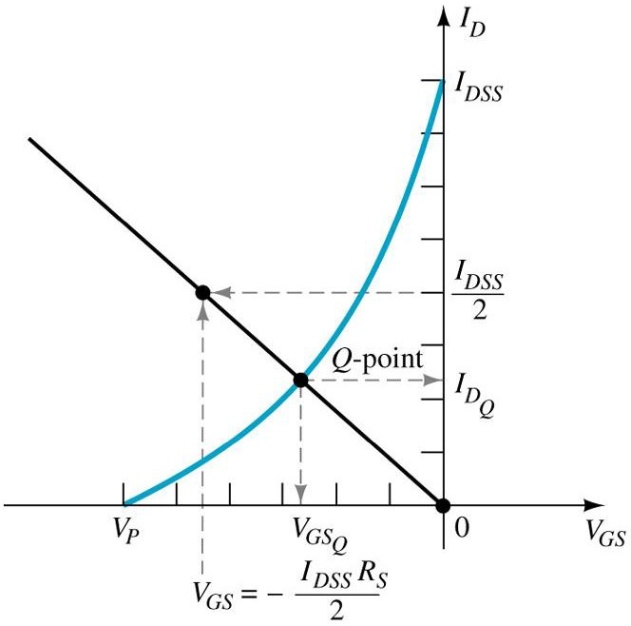
Self-biasing
Loop at input:
I_{G} = 0 => V_{G} = 0V → V_{GS} = - I_{S}R_{S} (1)
I_{D} = I_{DSS}(1-V_{GS}/V_{p})² (2)
To determine Q point:
➔ Sole the equation system: (1) + (2)
➔ Or by using curve method as shown in the paragraph (intersection point)
Consider the impact of Temp.?

Slide 39
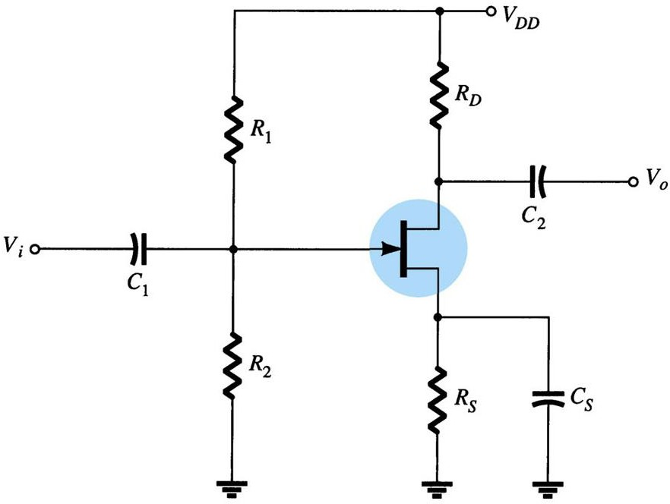
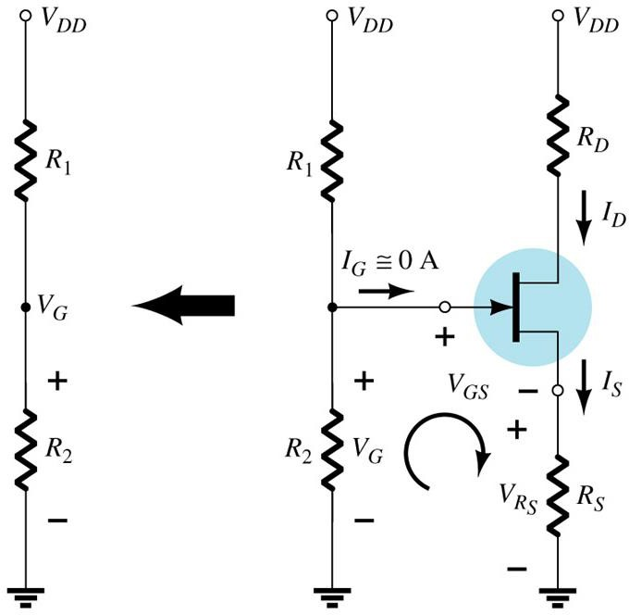
Voltage divider biasing (ex: JFET)
I_{G} = 0, output current I_{D} is controlled by V_{GS}
This biasing method is usually used for FET

Slide 40
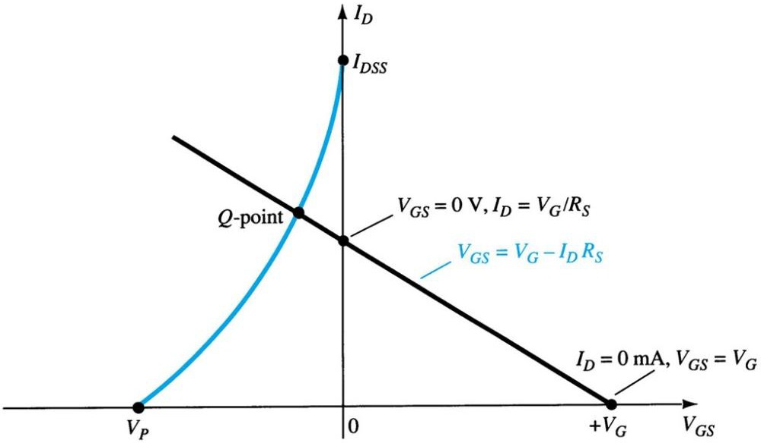
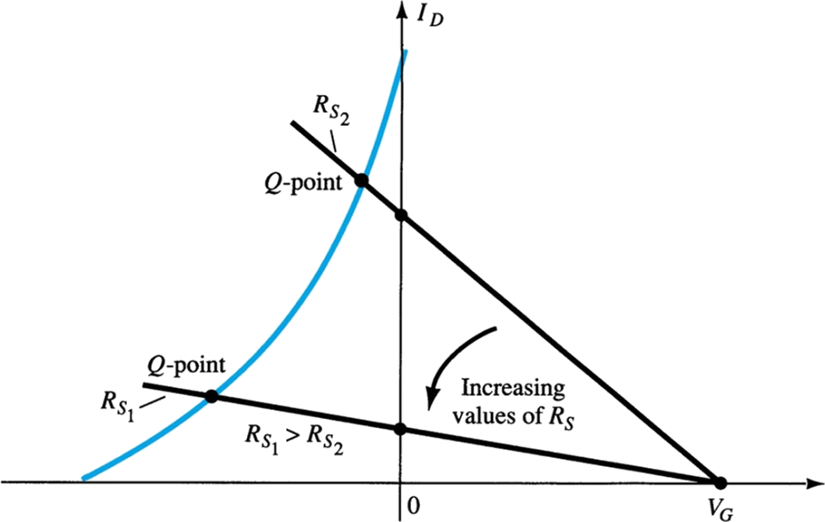
Voltage divider biasing (ex: JFET)
V_{G} = V_{DD}R₂/(R₁+R₂)
➔ DC load line is: V_{GS} = V_{G}- I_{D}R_{S} (1)
R_{S} varies → shift of Q point and DC load line
Characteristic curve of FET I_{D} = I_{DSS}(1-V_{GS}/V_{P})² , (2)
To determine Q point:
➔ Sole the equation system: (1)+(2)
➔ Or by using curve method as shown in the paragraph (intersection point)

Slide 41
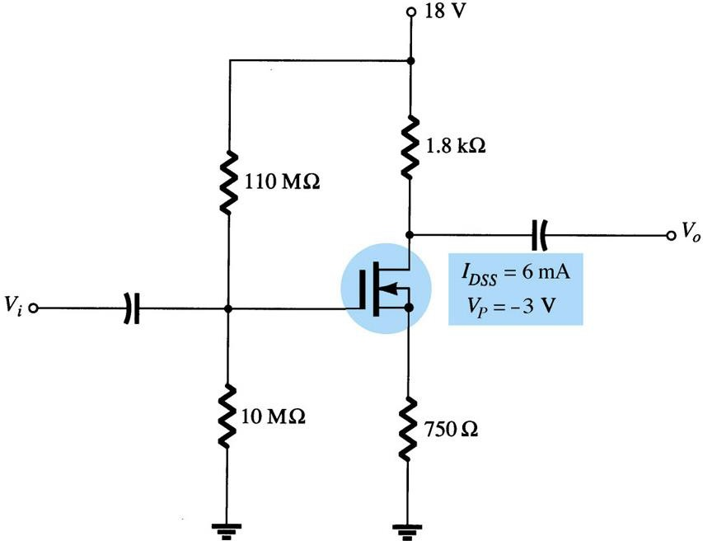
Voltage divider biasing (ex: DMOSFET)
V_{G} = V_{DD}* 10MΩ/(110MΩ+10MΩ)
➔ DC load line: V_{GS} = V_{G} – I_{S}*750Ω (1)
I_{D} current of DMOS:
I_{D} = I_{DSS}(1-V_{GS}/V_{P})² (2)
To determine Q point:
➔ Sole the equation system: (1) + (2)
➔ Or by using curve method as shown in the paragraph (intersection point)

Slide 42
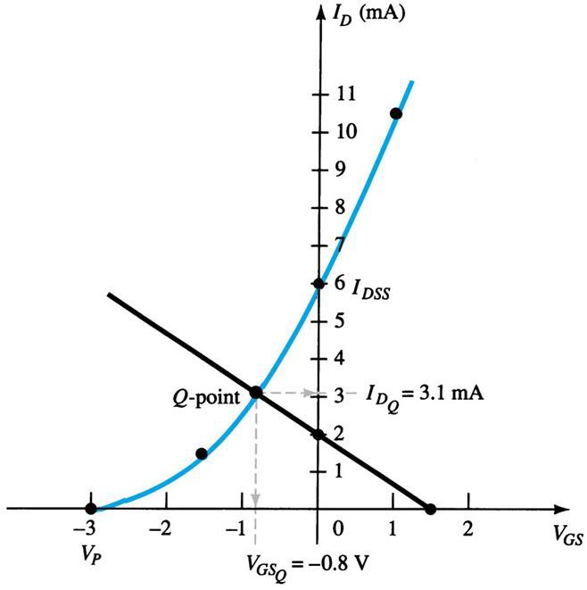
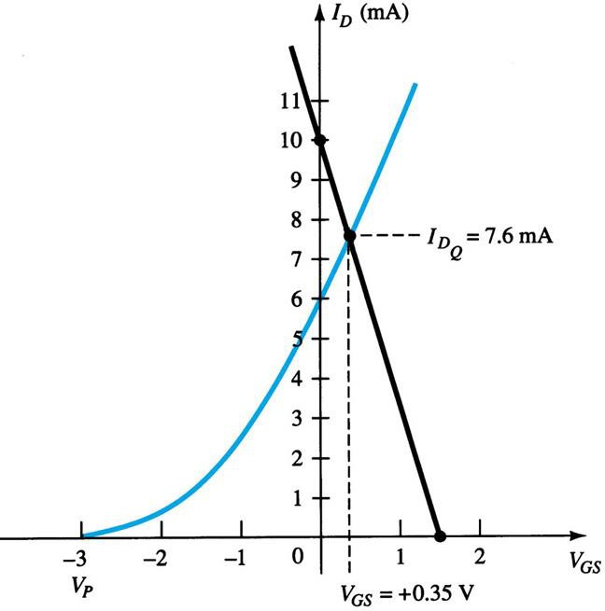
Voltage divider biasing (ex: DMOSFET)
With DMOS: I_{D} = I_{DSS}(1-V_{GS}/V_{P})²
V_{GS} can be positive

Slide 43
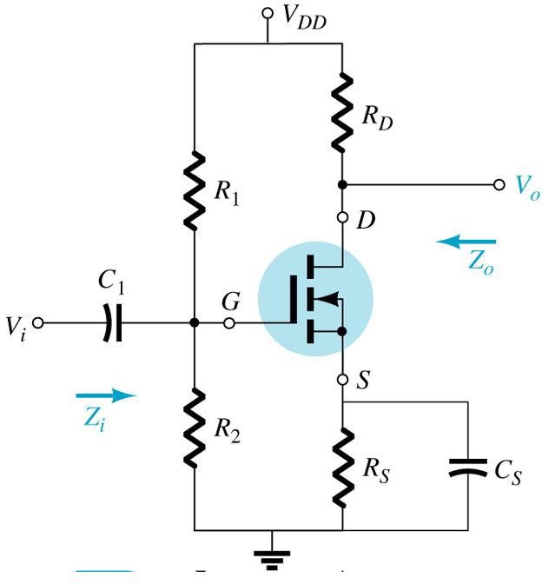
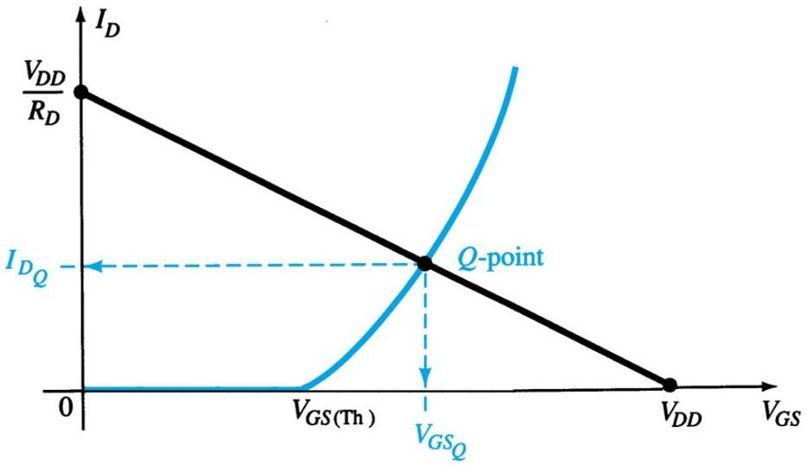
Voltage divider biasing (E-MOSFET)
With EMOS:
I_{D} = k(V_{GS}-V_{T})²
k=I_{Don}/(V_{GSon}-V_{T})₂

Slide 44
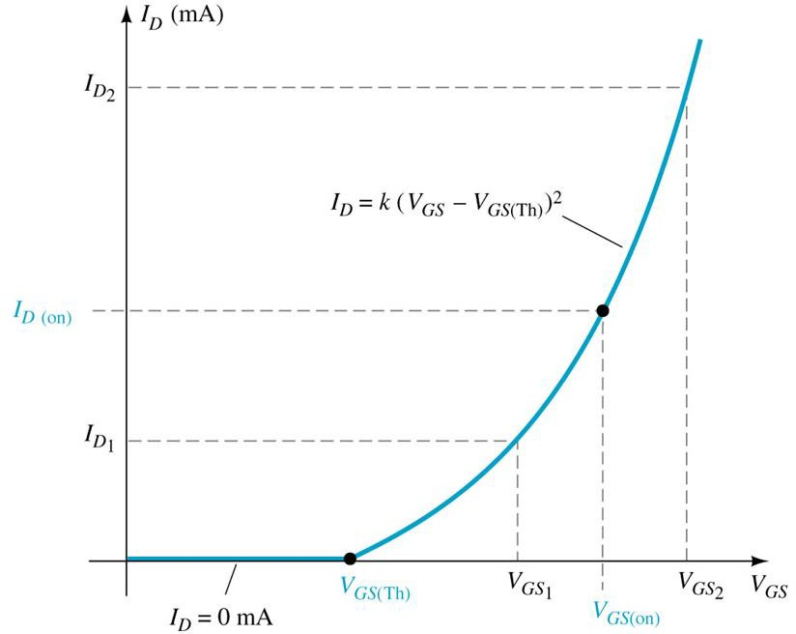
Voltage divider biasing (ex: E-MOSFET)
With EMOS: I_{D} = k(V_{GS}-V_{T})²
where k = I_{D-on}/(V_{GSon}-V_{T})²
Draw transfer characteristic
curve of E-MOSFET

Slide 45


Feedback biasing (ex: E-MOSFET)
➔
At the node G:
I_{G} = 0 → V_{G} = V_{D}

Slide 46


Feedback biasing (ex: E-MOSFET)
At the node G: I_{G} = 0 => V_{G} = V_{D}
DC load line
V_{GS} = V_{DS} = V_{DD} - R_{D}I_{D} (1)
Transfer char. equation: I_{D} = k(V_{GS} - V_{T})² ,
k = I_{Don}/(V_{GSon}-V_{T})²
(2)
Solve equ. Sys. (1,2) or use paragraph method

Slide 47


Example
Question: Determine Q (I_{D}, V_{GS}) point Q of these circuits?

Slide 48


Example
Question: Determine Q (I_{D}, V_{GS}) point Q of these circuits?

Slide 49


Example
Question: Determine V_{GS} and
Question: Determine I_{D} with V_{th} = 3V.
^{V}DS
for the E-MOSFET circuit
above. Given that this MOSFET has minimum values of I_{D(on)} = 200 mA at V_{GS} = 4V and V_{th} = 2V.

Slide 50
Analyze the circuit for AC signal (small signal)
51

Slide 51


Small signal model
52

Slide 52

Transconductance
g_{m} = ∆I_{D} / ∆V_{GS} = d(I_{D}(V_{GS}))
Derivation of current I_{D} as function of V_{GS}
Slope of I_{D}(V_{GS}) at Q point

Slide 53
Transconductance g_{m} (JFET & DMOS)
For E-MOS; gm is defined from Shockley equation:
_{gm =} 2IDSS ⎡₁ ₋ VGS ⎤
⎢⎣
VP VP ⎥⎦
When V_{GS} = 0:
_{gm0 =} 2IDSS
VP
g_{m} determined at Q point:
gm =gm0 ⎡ − ^{VGS ⎤}
⎢1
_{V} ⎥
⎣
P ⎦

Slide 54


Transconductance g_{m} (E-MOSFET)
For JFET & DMOS, gm is defined from:
g_{m} determined at Q point:

Slide 55

AC equivalent circuit (EMOS)
Notes:
V_{GS} should be positive for NMOS and negative for PMOS
g_{m} = 2k(V_{GS} – V_{T})

Slide 56
3 types of MOSFET amplifier
CS – CD – CG

Slide 57


EMOS – CS with fixed bias voltage
VDD
Input at G terminal, output at D
terminal → Common Source
Fixed biasing (S grounded)
To draw AC equivalent circuit
  Short circuit all capacitors
  Short circuit power supply
RD
Vout
Cout N-EMOS
_{Vin} Cin
RG
+ _{V1}
10V
AC equivalent
circuit

Slide 58

EMOS – CS with fixed bias voltage
Z_{i} = R_{G}
Z_{o} = r_{d}//R_{D}
≈ R_{D}
if r_{d} > 10R_{D}
A_{V} = - g_{m}(r_{D}//R_{D}) ≈ - g_{m}R_{D} if r_{d} > 10R_{D}
Input and output voltage are out of phase

Slide 59

EMOS – CS with voltage divider
VDD
Input at G terminal, output at D terminal → Common Source
Voltage divider
S terminal is connected to Rs and Cs in parralel
R1
RD
Vout
D
C1
_{Vin} 1uF
Cout
G
N-EMOS
R2
S
RS
Cs
AC equivalent circuit

Slide 60
EMOS – CS with voltage divider
Z_{i} = R₁// R₂
Z_{o} = r_{d}//R_{D} | ≈ R_{D} | nếu r_{d} > 10R_{D}
A_{V} = -g_{m}(r_{D}//R_{D}) | ≈ g_{m}R_{D} | nếu r_{d} > 10R_{D}
Input and output voltage are out of phase

Slide 61
EMOS – CS with voltage divider and wo. Cs
VDD
Input at G terminal, output at D terminal → Common Source
Voltage divider
S terminal is connected to ONLY Rs and REMOVE bypass-capacitor C_{S}
R1
RD
Vout
D
C1
_{Vin} 1uF
Cout
G
N-EMOS
_{RS X}Cs
R2
S
?????
AC equivalent circuit

Slide 62

EMOS – CS with voltage divider and wo. Cs
VDD
Input at G terminal, output at D terminal → Common Source
Voltage divider
S terminal is connected to ONLY Rs and REMOVE bypass-capacitor C_{S}
R1
RD
Vout
D
C1
_{Vin} 1uF
Cout
G
N-EMOS
_{RS X}Cs
R2
S
AC equivalent circuit

Slide 63
EMOS – CS with voltage divider and wo. Cs
Z_{i} = R_{G} (or R1//R2) Z_{o} = R_{D}/[1+g_{m}R_{S}+(R_{D}+R_{S})/r_{d}]
A_{V} = -g_{m}R_{D}/[1+g_{m}R_{S}+(R_{D}+R_{S})/r_{d}]
Input and output voltage are out of phase

Slide 64

EMOS – CS with feedback bias
Input at G terminal, output at D terminal: Common Source
Feedback biasing
To draw AC equivalent circuit
  Short circuit all capacitors
  Short circuit power supply

Slide 65


EMOS – CS with feedback bias
AC equivalent circuit
  Short circuit all capacitors
  Short circuit power supply
➔

Slide 66
EMOS – CS with feedback bias
Z_{i} = (R_{F}+r_{d}//R_{D})/[1+g_{m}(r_{d}//R_{D})]
≈ R_{F}/(1+g_{m}R_{D}) with r_{d} >10R_{D}, R_{F}>>r_{d}//R_{D}
Z_{o} = R_{F}//r_{d}//R_{D} ≈ R_{D} with r_{d} >10R_{D}, R_{F}>>r_{d}//R_{D}
A_{V} = g_{m} R_{F}//r_{d}//R_{D} ≈ g_{m}R_{D} with r_{d} >10R_{D}, R_{F}>>r_{d}//R_{D}
Output and input voltage are out of phase

Slide 67


EMOS – CS with feedback bias
68

Slide 68

EMOS – CS with feedback bias
69

Slide 69


EMOS – CS with feedback bias
70

Slide 70

JFET – CD with fixed biasing
Input at G terminal, output at S terminal: Common Drain
Fixed biasing

Slide 71

JFET – CD with fixed biasing
Z_{i} = R_{G}
Z_{o} = r_{d}//R_{S}//(1/g_{m}) ≈ R_{S}//(1/g_{m})
if r_{d} > 10R_{S}
A_{V} = -g_{m}(r_{d}//R_{S})/[1+g_{m}(r_{d}//R_{S})] ≈ g_{m}R_{S}/[1+g_{m}R_{S})]
≈ 1
if r_{d} > 10R_{S}
if g_{m}R_{S} >> 1

Slide 72

JFET – CG with fixed biasing
Input at S terminal, output at D terminal:
Common GATE
Fixed biasing

Slide 73




JFET – CG with fixed biasing
Z_{i} = R_{s}//[(r_{d}+R_{D})/(1+g_{m}r_{d})] | ≈ R_{S}//(1/g_{m}) | nếu r_{d} >10R_{D}
Z_{o} = r_{d}//R_{D} | ≈ R_{D} | nếu r_{d} >10R_{D}
A_{V} = [g_{m}R_{D}+ (R_{D}/r_{d})]/[1+ R_{D}/r_{d}] | ≈ g_{m}R_{D} | nếu r_{d} >10R_{D}
Input and output voltage are IN-PHASE

Slide 74

Equivalent circuit for DMOS
Similar to JFET and E-MOSFET
For DMOS:
  V_{GS} can be positive for Nchannel and negative for P channel
  g_{m} can be higher than g_{m0}

Slide 75


Resume
77

Slide 76


Resume
78

